Slide 1
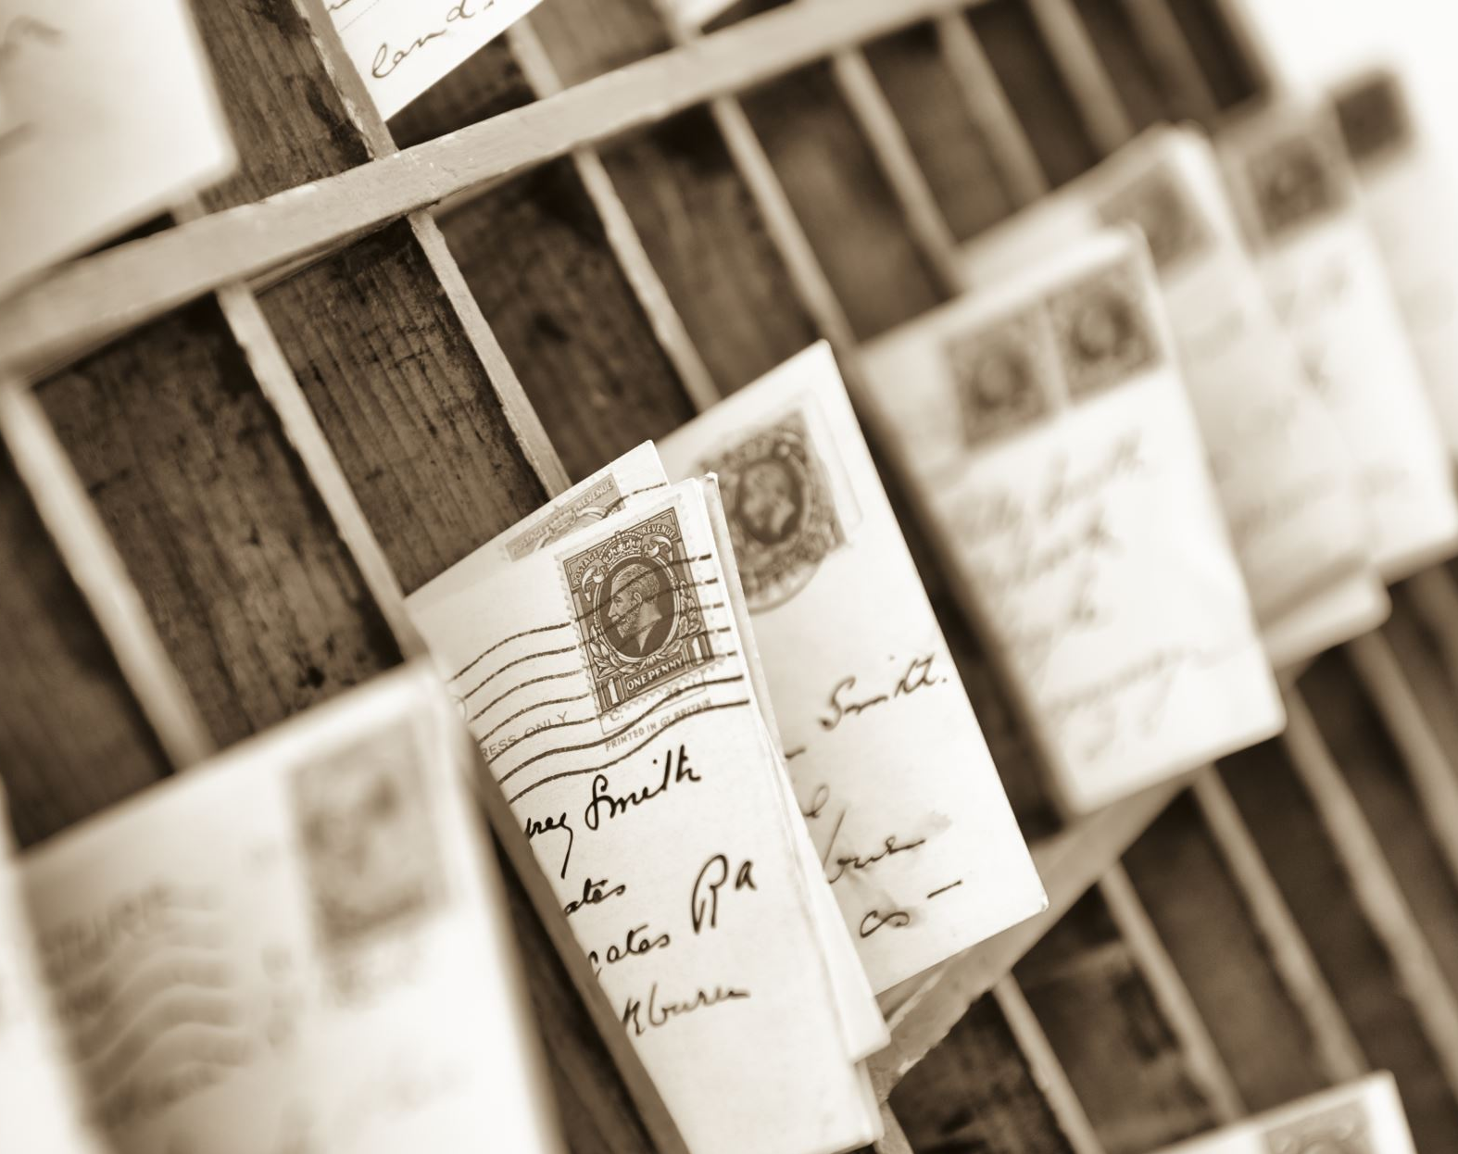
Binarization of Historical Documents
Artificial Intelligence:CS370
Instructor : Dr. Imran Malik
Team Members
Ghulam Hussain Khan Sherwani
Muhammad Irfan
Abdul Basit Sajid

Slide 2

Introduction
Importance of Historical Documents
Challenges in preserving historical documents
Overview of Binarization as a solution
Significance of the project

Slide 3

Binarization Algorithms
- Thresholding
- Otsu's method
- Niblack's thresholding

Slide 4

Project Methodology
Data Collection
Image Preprocessing
Model Architecture
Model training
Conclusion and Recommendations

Slide 5

Data Collection
Document Image Binarization Competition, DIBCO and H-DIBCO (years: 2009, 2010, 2011, 2012, 2013, 2014, 2016, 2017, 2018)
The Nabuco Dataset
PHIBD 2012
Binarization of Palm Leaf Manuscript Images, 2016. Dataset

Slide 6
Image Preprocessing
We load and preprocess data using OpenCV and NumPy by converting the image to 256X256 RGB image

Slide 7
Model Architecture
U-Net Architecture
a convolutional neural network designed for image segmentation tasks.
Model Compilation
Utilizing Adam optimizer and Binary Crossentropy loss for model compilation.

Slide 8
Post Processing
The output of the model is a gray scale image and we apply threshold of 0.5 on it to get binary image

Slide 9

Model Training
Training Configuration: 200 epochs and batch size is 10, learning rate 1e-4
Training Execution: The model is trained on the prepared dataset using the fit method.

Slide 10
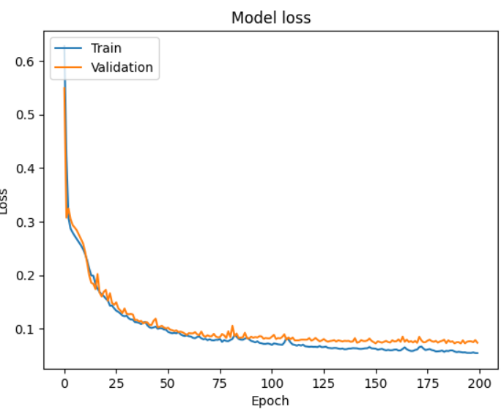
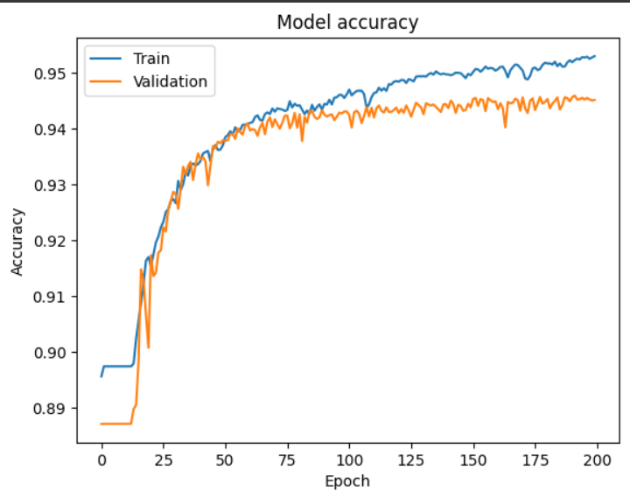
Results Validation

Slide 11
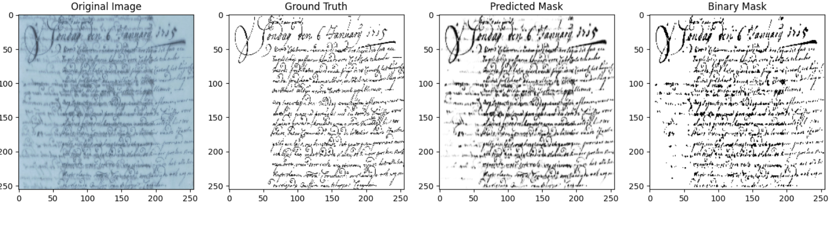
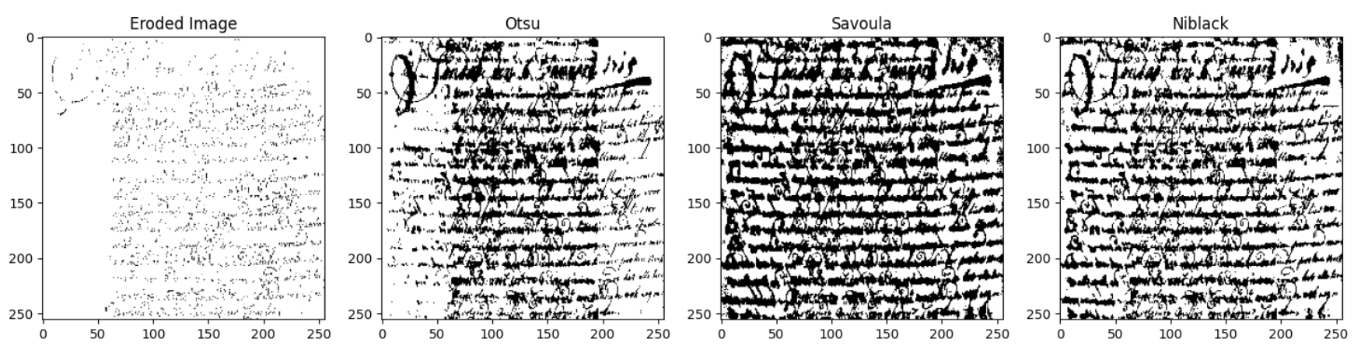
Results

Slide 12
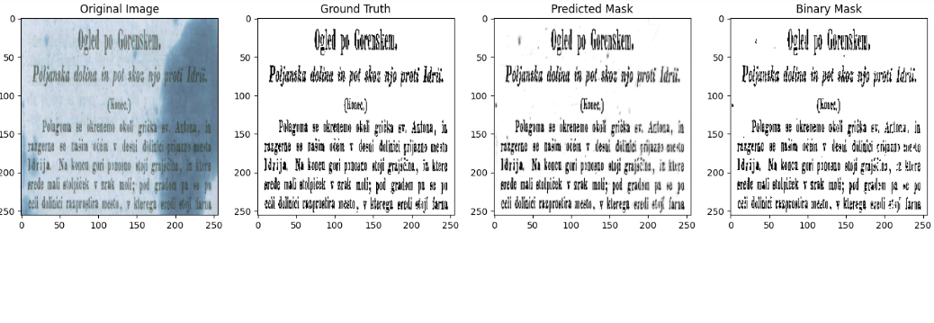
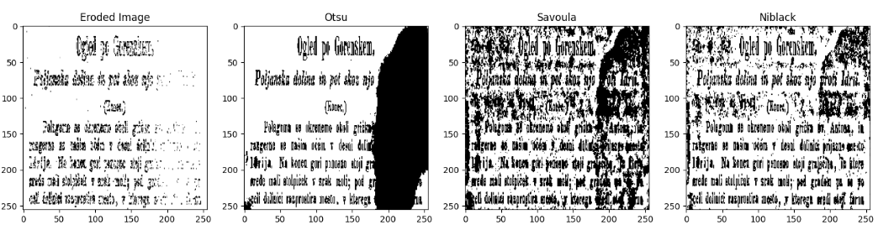
Results

Slide 13
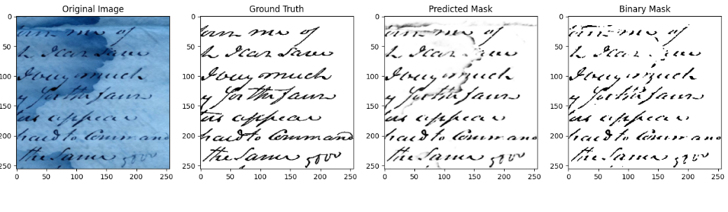
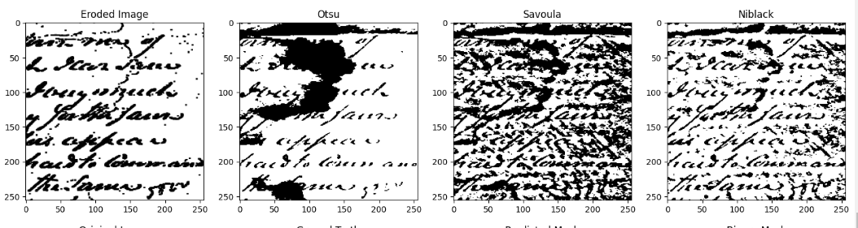
Results

Slide 14
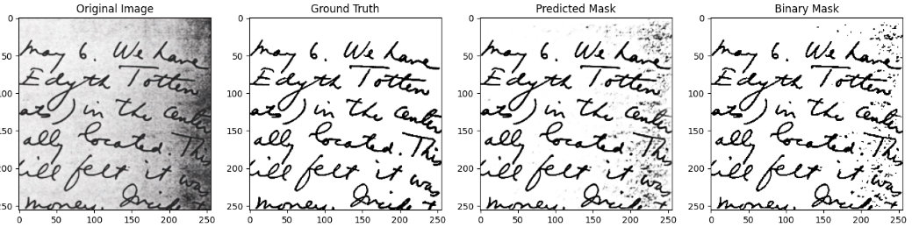
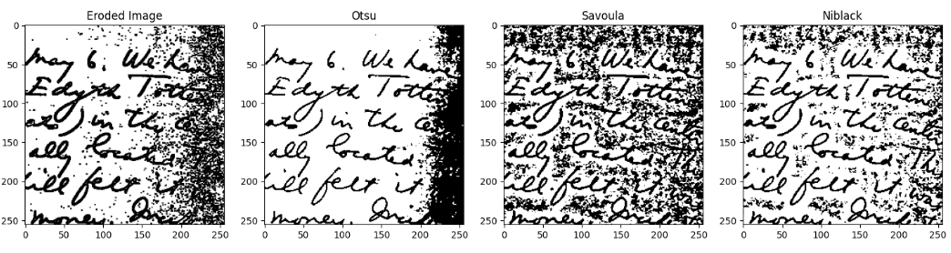
Results

Slide 15
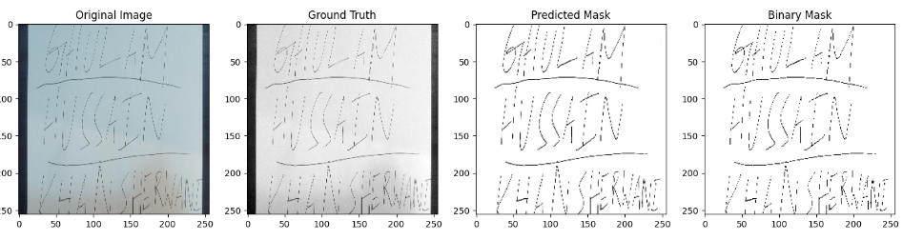
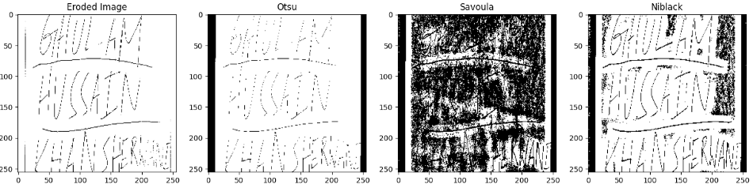
Results

Slide 16

Conclusion
Overview of the project
Key findings and contributions

Slide 17

Next Steps
Potential future research
Application of the developed algorithm
Acknowledgments and thank you

Slide 18

Q&A
Your Thoughts?

